Slide 1
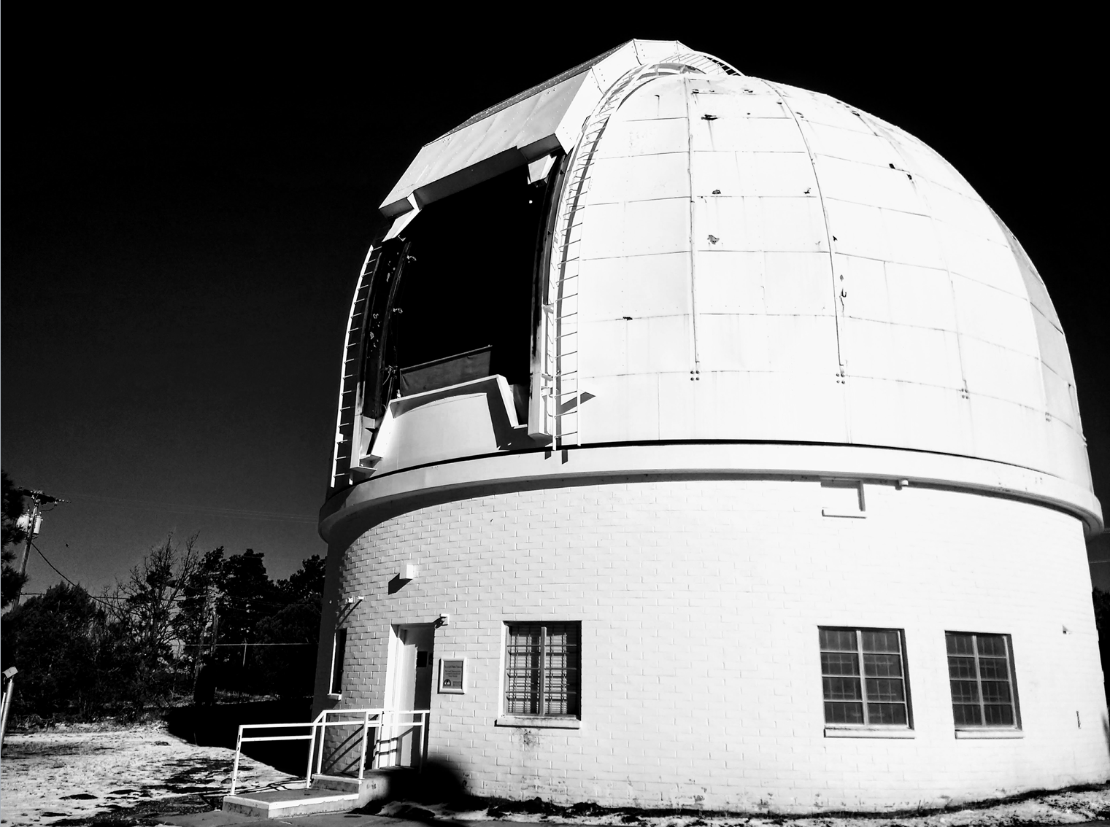
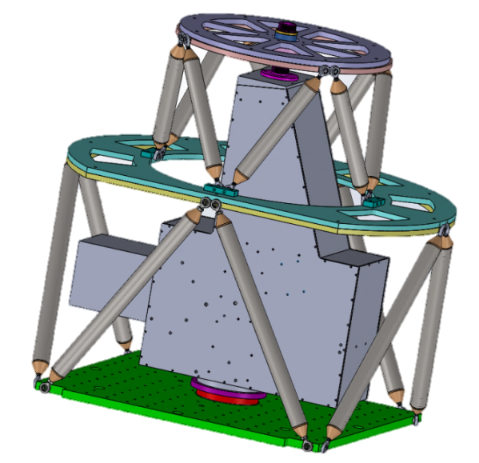
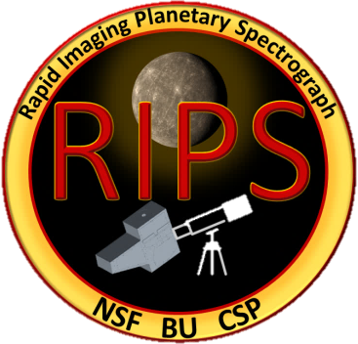
RIPS: the Rapid Imaging Planetary Spectrograph
First light at the Perkins 1.8m, 15 March 2018

Slide 2
Overview
RIPS was designed for concurrent imaging and long-slit high resolution spectroscopy on the same detector
By utilizing “lucky imaging” techniques (i.e., via rapid imaging), RIPS can overcome atmospheric seeing, thereby precisely identifying the locations of spectral emissions around resolved Solar System objects
In addition, the natural motion of the slit across the target object allows for high resolution spectral imaging
RIPS has slots for 1” filter wheels or 2” single filters (in both imaging and spectral paths). Current available filters include:
1”: NaI (45Å wide), SII (45Å), KI (45Å), various neutral density filter combinations
2”: NaI (4Å), NaI (18Å), KI (14Å), OI (~20Å)
RIPS is controlled by 5 motors:
Slit motor (~15 μm minimum width)
Grating motor (echelle grating angle)
Spectral focus motor
Imaging (slit) focus motor
RIPS rotation within cage (optional, rotates slit on sky)

Slide 3
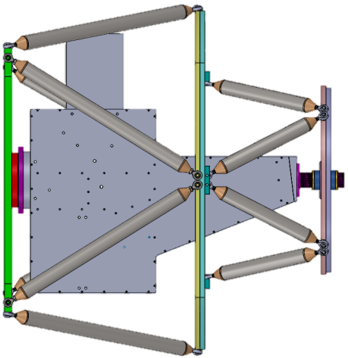
Schematic
R ~ 80,000 (for 3 pixel FWHM)
24.6 mÅ/pixel dispersion
(or 1.25 km/s/pixel at 5900Å)
Detector Andor iXon 1024x1024 EMCCD
Plate scale: 0.106″/pixel (on Perkins at f/17.5)
Plate for attachment to telescope
EMCCD
Light from telescope
slit
900 mm f.l. F/9 achromat
white light
light from grating
light from slit
Re-imaging optics
1” filter wheel or 2” single filters
38.6 L/mm echelle
Rotation “cage”

Slide 4
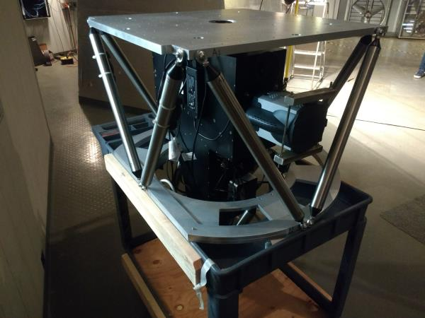
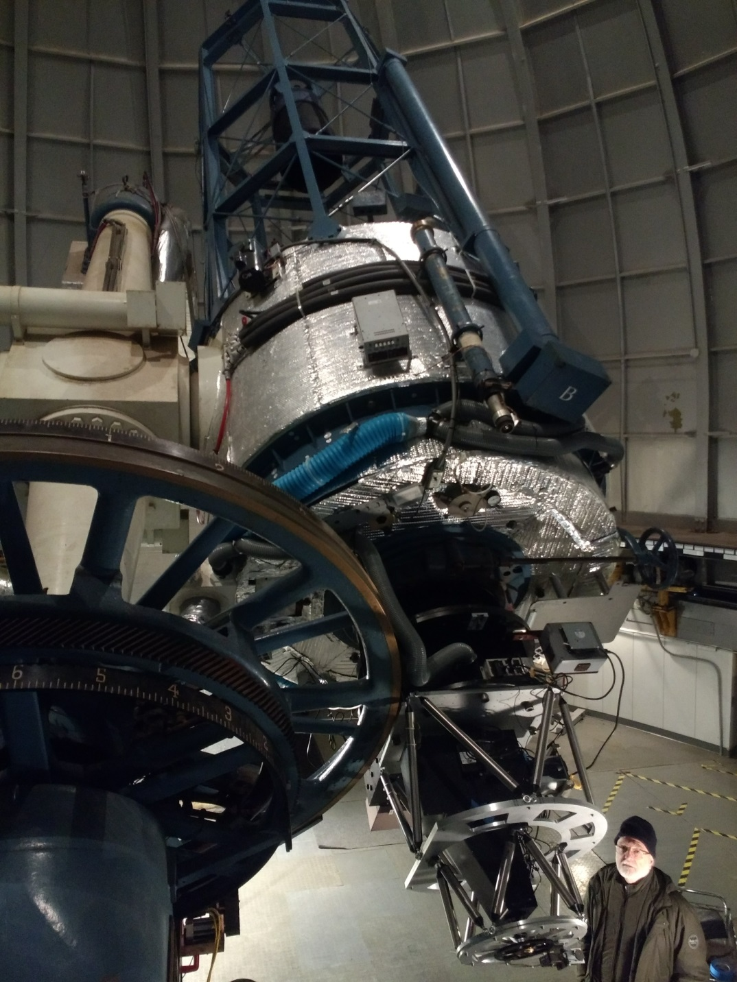
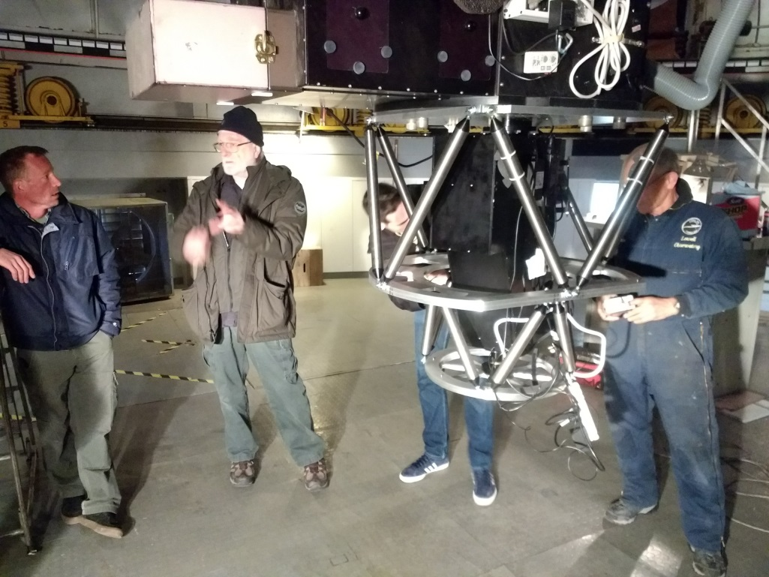
RIPS: First light at Perkins 1.8m in AZ

Slide 5
RIPS: First light at Perkins 1.8m in AZ
30Å FSR
Mercury’s Na D lines (in emission)
1” order sorting filter:
- NaI (45Å)
spectral channel
solar Na D lines
(dark bands: 5890Å and 5896Å)
spectral slit
2” filter:
- NaI (4Å) + ND1
Imaging channel
Mercury
(~96º phase angle)
20 fps (0.05 s integrations)
Notes:
We have ~20 min of similar data, roughly half in K and half in Na

